Slide 1
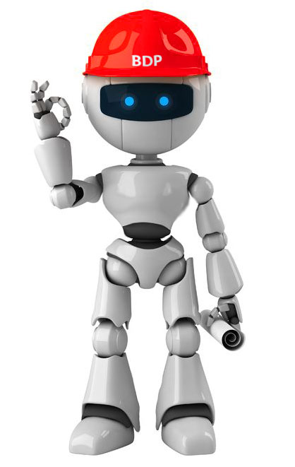
Ayla
The Story so Far

Slide 2
Ayla is an open A.I. platform for automated:
QA auditing
Technical checks
Error hunting
Error correction
This is part of our larger strategy for:
Continuous enhancement of our service
Never repeating an error twice
Approaching 100% perfection in error free tender documents
Approaching 100% practical QA compliance
Ayla is used in conjunction with an Automated Tool Suite:
Review checklists . calculation templates. Drawing templates and pallets. Equipment schedules, standard spec templates etc.

Slide 3
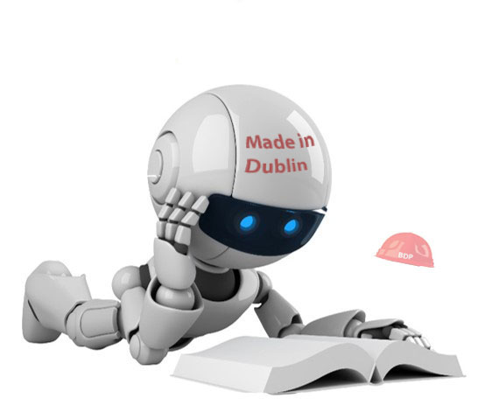
What does Ayla do?

Slide 4



Checks for Required Files at Particular Stages
Stage 1:
Project Director’s Brief
Project Contacts
Etc.
Stage 2b:
2b Electrical Checklist
2b Electrical Design Review
2b Mechanical Checklist
2b Mechanical Design Review
Etc.
Informs project runners of missing files and where to save them

Slide 5



Checks for Copies of Files
REP001.doc
REP001.doc
REP001.doc
REP001.doc
Folder A
Folder B
Folder C
Folder D
Directs project runners to copied files so they can delete them and avoid confusion

Slide 6
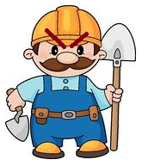
Checks for Particular Phrases or Outdated References
Searchs all word documents for phrases that are likely to cause issues:
e.g. – “The contractor should do something”
…and for references that have been superseded.
Just because I should doesn’t mean I shall!
I’ll can install as per the old guidelines instead!

Slide 7
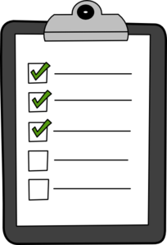
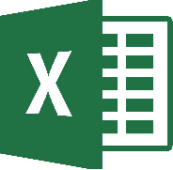
Ensures All Calculations are Indexed and Checked
Excel Based Calculations:
Makes sure there’s a calculation index on file.
Automatically finds and indexes new calculations
Automatically performs checks on standard calculations
Records who created / checked calculations and when
Informs the project runner of unindexed / unchecked calculations

Slide 8

Records Project Handbook Updates
Automatically detects when a project’s details have changed and makes a record of the change.
The changes are recorded in excel format to allow previous records to be easily examined.
Stage
Area
Design Team
Contacts
Significant Dates
Etc.

Slide 9



Performs Miscellaneous Checks
Ensures that spell check is turned on in word documents
Ensures that file paths are not too long (which can confuse Newforma)

Slide 10
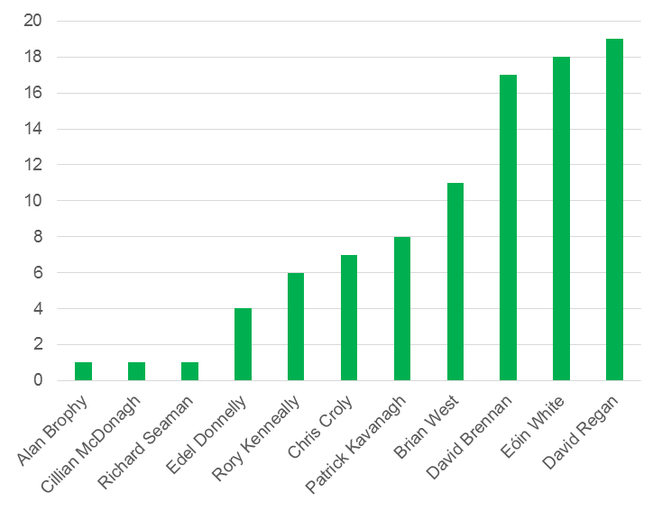
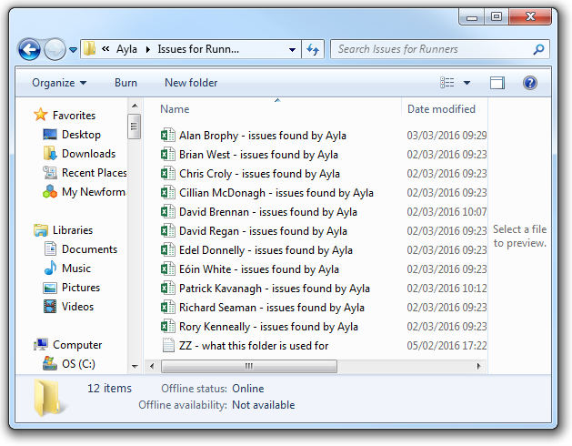
Automatically Delegates QA Tasks
Provides each project Runner with their own list of QA issues (and how to resolve them)

Slide 11

Continuously Improves QA:
Ayla identifies mistakes to project runners and tells them how to fix them.
Project runners can also identify when Ayla has made a mistake and can inform her so that she won’t do it again.
This cycle continuously improves QA within the office.
Contractors are evil

Slide 12

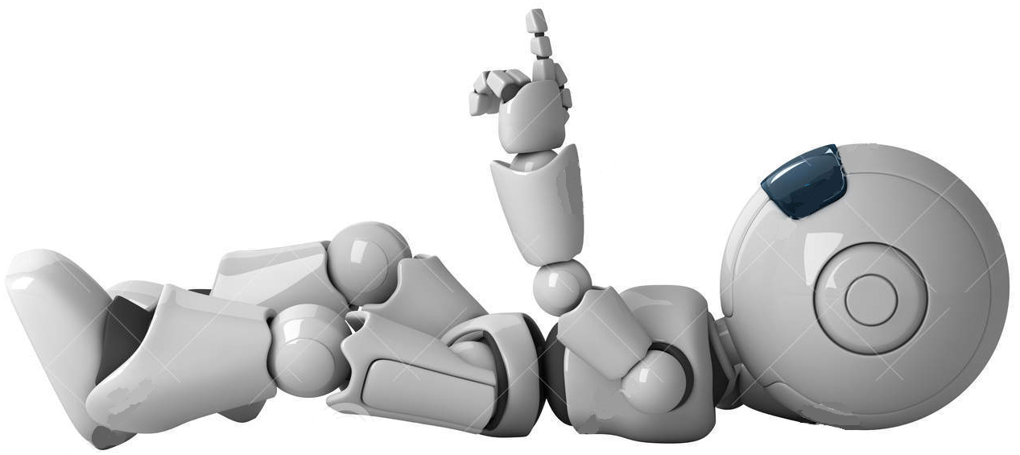
Ayla is Easily Portable & Configurable
Ayla is based in Excel.
Any computer with Excel can use Ayla.
Ayla can be configured to any network / drives.
Ayla’s standard set of rules can be customised to individual requirements.
Additional checks can be easily added or removed
(simply by adding a row in excel)
Checks can be activated / disabled when necessary

Slide 13
Dublin Results

Slide 14
 | Before | After
Duplicate files (could result in the use of the wrong file) | 766 | 20
Missing Project hand book historic records | 649 | 0
Calculations that were not indexed | 649 | In progress
Missing critical information in Project hand books | 304 | 10
Banned phrases used (should instead of shall etc) | 247 | 6
Calculations that were not checked | 106 | In progress
Missing design reviews | 106 | 0
Missing Project task lists | 101 | 2
Missing Project Risk assessments | 86 | 3
Files saved in the wrong place | 62 | 0
Missing design checklists | 80 | 0
Calculation indexes missing | 20 | 0
Incorrect references to superseded standards | 33 | 5
Before and after Ayla – M&E

Slide 15
 | Before | After
Missing H&S Briefings | 10 | 0
Missing project directors briefs | 12 | 0
Missing contacts list | 5 | 0
Missing project hand books | 0 | 0

